Slide 1
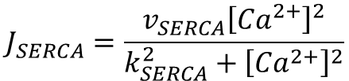

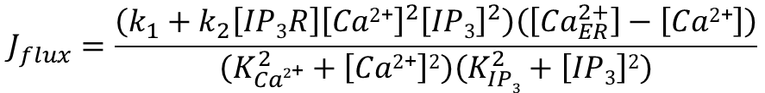
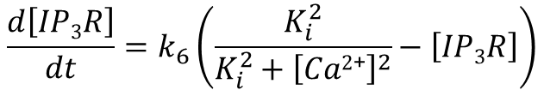




Homogenized model
$$\frac{∂\left[Ca2\text{+}\right]}{∂t}=J_{flux}−J_{SERCA}+J_{media}+D_{Ca2\text{+}}∇^{2}\left[Ca2\text{+}\right]$$
$$J_{flux}=\frac{\left(k_{1}+k_{2}\left[IP3R\right]{\left[Ca2\text{+}\right]}^{2}{\left[IP3\right]}^{2}\right)\left(\left[{Ca}_{ER}^{2+}\right]−\left[Ca2\text{+}\right]\right)}{\left(K_{Ca2\text{+}}^{2}+\left[Ca2\text{+}\right]2\right)\left(K_{IP3}^{2}+\left[IP3\right]2\right)}$$
$$\frac{d\left[IP3R\right]}{dt}=k_{6}\left(\frac{K_{i}^{2}}{{K_{i}^{2}+\left[Ca2\text{+}\right]}^{2}}−\left[IP3R\right]\right)$$
$$J_{SERCA}=\frac{v_{SERCA}{\left[{Ca}^{2+}\right]}^{2}}{{k_{SERCA}^{2}+\left[{Ca}^{2+}\right]}^{2}}$$
$$\frac{d\left[{Ca}_{ER}^{2+}\right]}{dt}=−\frac{V}{V_{ER}}\left(J_{flux}−J_{SERCA}\right)$$
$$J_{media}=v_{leak}−k_{leak}\left[Ca2\text{+}\right]$$
$$\frac{∂\left[IP3\right]}{∂t}=v_{PLC}−k_{deg}\left[IP3\right]+D_{IP3}∇^{2}\left[IP3\right]$$
$$v_{PLC}=Γ\left(1,μ_{PLC}\right)$$
Notes:
Formal separate PLCg term

Slide 2







Boundary and initial conditions
No-flux boundary conditions:
Spatial domain is 0 to L
$$∇\left[IP3\right]=0 at x=\{0,L\}$$
$$∇\left[Ca2\text{+}\right]=0 at x=\{0,L\}$$
Steady-state initial conditions:
$$at t=0:$$
$$\left[Ca2\text{+}\right]=0.05 μM$$
$$\left[IP3\right]=0.15 μM$$
$$\left[{Ca}_{ER}^{2+}\right]=80 μM$$
$$\left[IP3R\right]=1$$

Slide 3
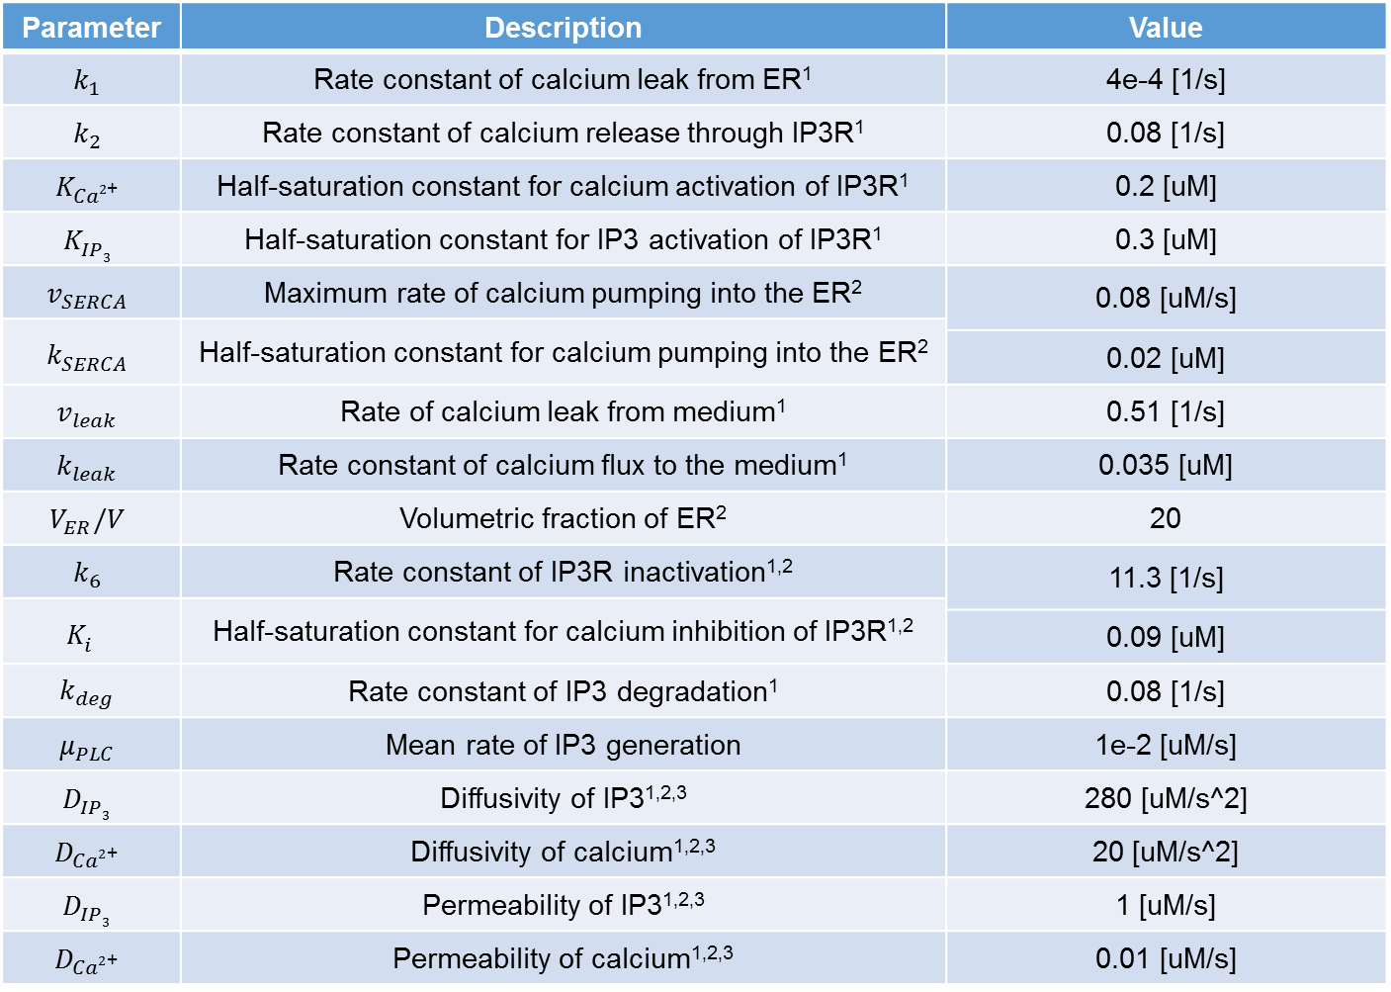
Parameter | Description | Value
$$k_{1}$$ | Rate constant of calcium leak from ER¹ | 4e-4 [1/s]
$$k_{2}$$ | Rate constant of calcium release through IP3R¹ | 0.08 [1/s]
$$K_{Ca2\text{+}}^{}$$ | Half-saturation constant for calcium activation of IP3R¹ | 0.2 [uM]
$$K_{IP3}^{}$$ | Half-saturation constant for IP3 activation of IP3R¹ | 0.3 [uM]
$$v_{SERCA}$$ | Maximum rate of calcium pumping into the ER² | 0.08 [uM/s]
$$k_{SERCA}^{}$$ | Half-saturation constant for calcium pumping into the ER²
 |  | 0.02 [uM]
$$v_{leak}$$ | Rate of calcium leak from medium¹ | 0.51 [1/s]
$$k_{leak}$$ | Rate constant of calcium flux to the medium¹ | 0.035 [uM]
$$V_{ER}/V$$ | Volumetric fraction of ER² | 20
$$k_{6}$$ | Rate constant of IP3R inactivation^{1,2} | 11.3 [1/s]
$$K_{i}^{}$$ | Half-saturation constant for calcium inhibition of IP3R^{1,2}
 |  | 0.09 [uM]
$$k_{deg}$$ | Rate constant of IP3 degradation¹ | 0.08 [1/s]
$$μ_{PLC}$$ | Mean rate of IP3 generation | 1e-2 [uM/s]
$$D_{IP3}$$ | Diffusivity of IP3^{1,2,3} | 280 [uM/s^2]
$$D_{Ca2\text{+}}$$ | Diffusivity of calcium^{1,2,3} | 20 [uM/s^2]
$$D_{IP3}$$ | Permeability of IP3^{1,2,3} | 1 [uM/s]
$$D_{Ca2\text{+}}$$ | Permeability of calcium^{1,2,3} | 0.01 [uM/s]
1. Höfer, Thomas, Laurent Venance, and Christian Giaume. "Control and plasticity of intercellular calcium waves in astrocytes: a modeling approach." The Journal of neuroscience 22.12 (2002): 4850-4859.
2. Sneyd, J. A. M. E. S., et al. "Intercellular calcium waves mediated by diffusion of inositol trisphosphate: a two-dimensional model." American Journal of Physiology-Cell Physiology 268.6 (1995): C1537-C1545.
3. Keener, James P., and James Sneyd. Mathematical physiology. Vol. 1. New York: Springer, 1998.
Notes:
X means effect was observed.
- means no effect was observed.
Parameters were varied by 30% up and down.
Amplitude is the concentration of calcium at the maximum.
Steady state concentration is the concentration of calcium at the minimum.
Frequency is the number of wavefronts occurring per time.
Speed is the slope of the position/time curve of the wavefronts.

Slide 4
Homogenization
Cell topology was ignored through homogenization as described in¹
Permeability and Diffusivity terms were combined to obtain effective diffusivity for calcium and IP3
Effective diffusivities (after accounting for cell boundaries) are:
IP3: 9.66 uM/s^2
Calcium: 0.10 uM/s^2
1. Keener, James P., and James Sneyd. Mathematical physiology. Vol. 1. New York: Springer, 1998.

Slide 5



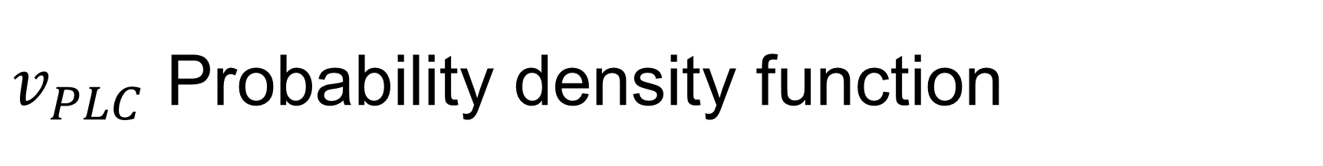






$v_{PLC}$ Probability density function
$$v_{PLC}=Γ\left(0.01,\frac{μ_{PLC}}{0.01}\right)$$
$$v_{PLC}=μ_{PLC}$$
$$v_{PLC}=Γ\left(1,μ_{PLC}\right)$$
$$σ^{2}=0.00$$
$$σ^{2}=μ_{PLC}^{2}$$
$$σ^{2}=100μ_{PLC}^{2}$$
$$μ_{PLC}$$
$$μ_{PLC}$$
$$μ_{PLC}$$
Represents an IP₃ generation signal with no noise.
Represents variable IP₃ generation signal where very high production rates can rarely occur, but production on average is the same as in pdf 1.
IP₃ signal with even higher variance than pdf 2. Here production rates will generally be very low but a greater frequency of high-rate events results in an average generation equal to pdf 1 and 2.
I called gamrnd in MATLAB to generate random numbers on this distribution

Slide 6
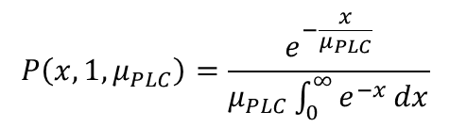
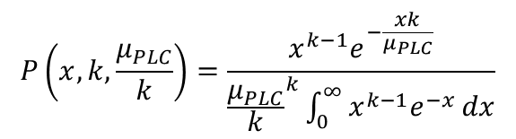
Stochastic term
I used multiple pdf’s including Gaussian for the stochastic term and always saw a transition as the variance increased with constant mean. I went with Gamma for this exploratory analysis because it most resembled the distribution of stimulus in discs in absence of serum
The following is the term used for the AIChE model:
The formal pdf for this term is:
I called gamrnd in MATLAB to generate random numbers on this distribution
$$v_{PLC}=Γ\left(1,μ_{PLC}\right)=Gamma\left(1,μ_{PLC}\right)$$
$$P\left(x,k,\frac{μ_{PLC}}{k}\right)=\frac{x^{k−1}e^{−\frac{xk}{μ_{PLC}}}}{{\frac{μ_{PLC}}{k}}^{k}\int_{0}^{∞}{x^{k−1}e^{−x}}dx}$$
$$P\left(x,1,μ_{PLC}\right)=\frac{e^{−\frac{x}{μ_{PLC}}}}{μ_{PLC}\int_{0}^{∞}{e^{−x}}dx}$$

